Slide 1
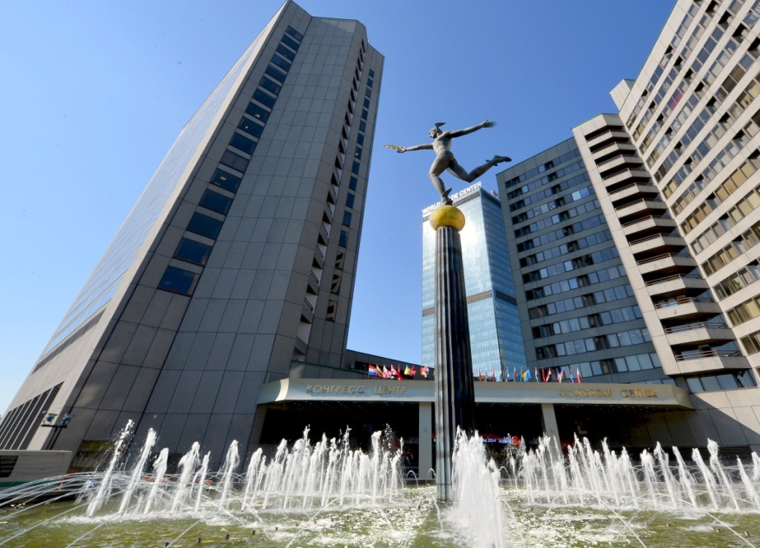
XXIV Plenary Meeting of ISO/TC 71
28/05/2018 – 01/06/2018
World Trade Center
12 Krasnopresnenskaya Embankment, Moscow, Russia
Hosted by TC 465 “Construction”, Federal Standardization Centre for Construction (FAU FCC)
www.faufcc.ru

Slide 2
ISO/TC 71 "Concrete, reinforced concrete and pre-stressed concrete" Subcommittees
ISO/TC 71 - Secretariat
American Concrete Institute/
ANSI United States
95 members from 38 countries
■ ISO/TC 71/SC 1—Test Methods for Concrete
■ ISO/TC 71/SC 3—Concrete Production and Execution of Concrete Structures
■ ISO/TC 71/SC 4—Performance Requirements for Structural Concrete
■ ISO/TC 71/SC 5—Simplified Design Standard for Concrete Structures
■ ISO/TC 71/SC 6—Nontraditional Reinforcing Materials for Concrete Structures
■ ISO/TC 71/SC 7—Maintenance and Repair of Concrete Structures
■ ISO/TC 71/SC 8—Environmental Management of Concrete Structures

Slide 3
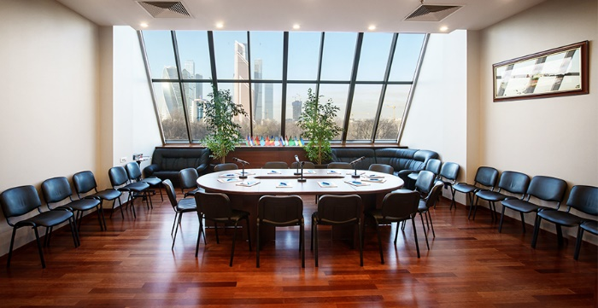
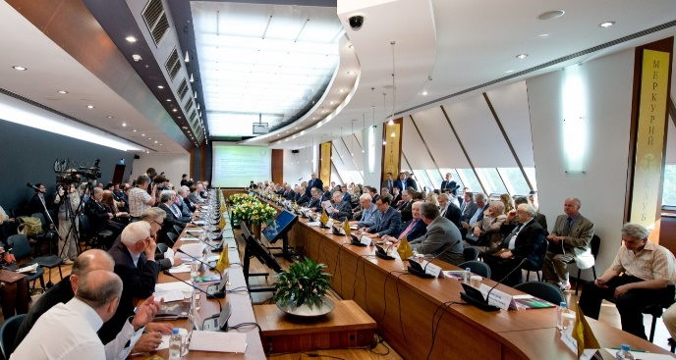
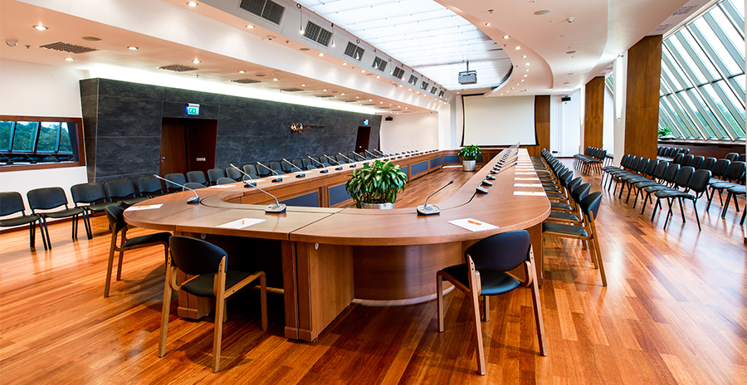
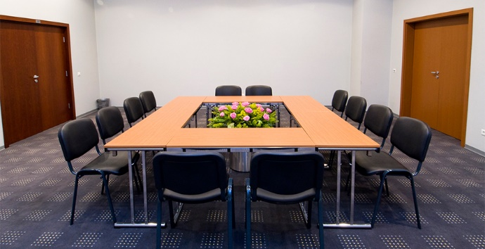
World Trade Center Congress Hall
28/05/2018 – 01/06/2018

Slide 4
Delegates and Key Speakers
More than 120 experts from 20 countries
STANDARDS INSTITUTE OF ISRAEL (SII)
STANDARDS NORWAY (SN)
AMERICAN CONCRETE INSTITUTE/ANSI UNITED STATES
INSTITUTO COLOMBIANO DE NORMAS TÉCNICAS Y CERTIFICACIÓN (ICONTEC)
JAPANESE INDUSTRIAL STANDARDS COMMITTEE (JISC)
KOREAN AGENCY FOR TECHNOLOGY AND STANDARDS (KATS)

Slide 5
Program
Concrete is the most widely used man-made product in the world. Approximately 4,7 tons of concrete is produced each year for every human being in the world (some 33 billion tons per year).
Standards in the concrete industry help to facilitate this large world-wide trade and help create durable, cost-effective structures. The standards also promote health and safety by standardizing design procedures for structural safety, reliability, serviceability, and resiliency. New standards related to both measuring and reducing the environmental impact of concrete production and use will aid in sustainability efforts around the world.
It is estimated that the production and consumption of concrete will see a rise of about of 2,5% per year for the next 3-5 years and as these structures age, a corresponding demand for maintenance and repair will grow.

Slide 6
XXIV Plenary Meeting of ISO/TC 71

